Slide 1

#LifeKoKaroLift
Data Science Program
‹#›

Slide 2


Module Name: EDA & Statistics
Course : Statistics
Lecture On : Statistics - Day - 8
Instructor :
‹#›

Slide 3
Today’s Agenda
Revision
Types of Sampling Methods
Standardised Normal Distribution and Z - Score
Sampling and Estimation
Key Takeaways
Data Science Certification Program
‹#›

Slide 4

Revision
In previous session, we learnt about:
Introduction: Central Limit Theorem
Samples
Sampling Distributions
Properties of Sampling Distributions
Estimating Mean Using CLT
Confidence Interval

Slide 5
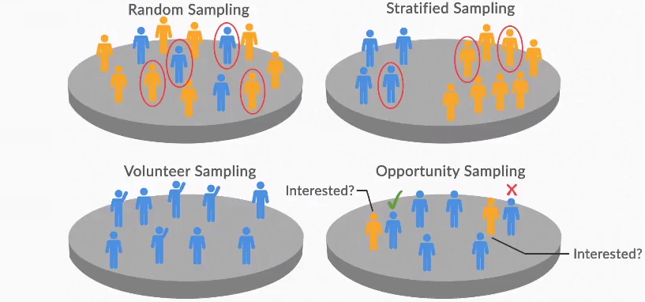
Types of Sampling Methods
As we saw in the last session, it is important to understand the process of sample data collection. For this, we will need to explore the various sampling methods.
Generally, these sampling methods are categorised into four types.

Slide 6
Types of Sampling Methods
Random sampling: In this kind of sampling, each element of the population has the same probability of getting selected in the sample.
Listed below are the various types of random sampling:
Simple random sampling with replacement: For creating a sample size n, you select an element from the population and then return it to the population. This procedure is repeated n times.
Thus, each element of the population can be selected more than once in a sample. This is used when the population size is small.
Simple random sampling without replacement: For the creation of a sample size n, you select an element from the population and do not return it to the population.
The selection of elements from the population is repeated n times. This is used when the population size is large.

Slide 7
Types of Sampling Methods
Stratified random sampling: The population is divided into strata based on common characteristics. The elements are then selected from these strata.
Cluster sampling: The population is divided into clusters, and then a simple random sample of these clusters is selected.
Systematic sampling: A starting point is selected in the population, and then the elements are selected at regular, fixed intervals.

Slide 8
Types of Sampling Methods
Non-random sampling: In this kind of sampling, each element of the population does not have the same probability of getting selected in the sample. Its various types are as follows:
Convenience sampling: The researcher selects the elements from the population on the basis of the convenient accessibility of these elements.
Judgemental sampling: The researcher selects the elements on the basis of his judgement and bias.

Slide 9
Types of Sampling Methods
Quota sampling: The population is divided into groups or quotas, on the basis of which you select the sample.
Quota sampling is, to a certain extent, similar to random sampling; the sampling procedure is more or less the same in both cases, except the quota is fixed in quota sampling. That is, you do not consider the entire population, just a section of it to create a quota.
Snowball sampling: In the case of snowball sampling, a small sample is first selected, say a sample of five people.
Then, each of the five members can suggest five names, and those five can suggest five more each. This creates a snowball effect.

Slide 10

Standardised Normal Distribution and Z- Score
A unique combination of the mean (μ) and standard deviation (σ) represents or defines a unique normal distribution. So, to analyse or compare different normal distributions, you use a standardised normal distribution.
A standardised normal distribution is a special type of normal distribution, where μ = 0 and σ = 1.
A normal distribution is converted into a standardised normal distribution with the help of the Z-score.
The formula for the Z-score is as follows:

Slide 11
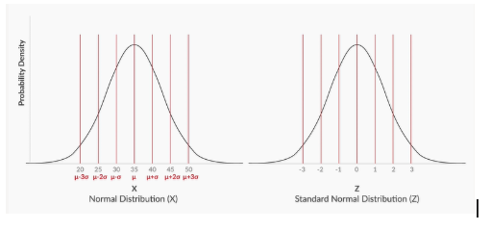
Standardised Normal Distribution and Z- Score
As it’s evident from the formula, for every value of x (or the values on the X-axis), we will calculate the corresponding Z scores using the formula above and plot these Z scores against their respective probabilities on the Y-axis.
For example, for a normal distribution with μ= 35 and σ = 5, the normal distribution curve and the standard normal distribution curve are illustrated in the image below.

Slide 12
Sampling and Estimation
Sampling distribution is the probability distribution of a particular sample statistic (such as the mean) obtained by drawing all possible samples of a particular sample size ‘n’ from the population and calculating their statistics.
Sampling Distribution of Sample Mean
If you draw samples of size, let’s say, ‘n’ from a population, calculate the sample mean for all the samples, and then draw the probability distribution for the random variable X (where X denotes the mean of the sample), the resulting probability distribution is called ‘sampling distribution of sample means’.
The mean of the sample means is denoted by μ(x), The standard deviation of the sampling distribution of the sample means is denoted by σ(x)

Slide 13
Sampling and Estimation
Central Limit Theorem
In simple words, the central limit theorem can be stated by the following method :
When you draw a sampling distribution of sample means, where the sample size is sufficiently large, the sampling distribution of the sample means will look like a normal distribution.
When is the sample size (n) considered sufficiently large?
For a non-normally distributed population, ‘n’ should be greater than or equal to 30. (This 30-rule is an oversimplification and can be verified.) For a normally distributed population, the sample size can be anything.

Slide 14
Sampling and Estimation
Significance of the central limit theorem
The central limit theorem states that for a sufficiently large sample, the sampling distribution is approximately normally distributed. This approximation improves with increased sample size because of this normal distribution.
The sampling distribution of sample means has its own normal variate (Z). In the next section, you will see how this Z is used to estimate population parameters.
An important property is as follows:
Mean of the sample means (μx̅) = Mean of the population (μ)
σ(x) = σ / √n, where n is the sample size of all the samples.
So, the normal variate or the Z-score for the sampling distribution of a sample means is:
Z = ( x̅ - μ ) / ( σ / √n )

Slide 15
Sampling and Estimation
Estimation
The process of drawing inferences about a population using the information from its samples is known as an estimation.
The following are the types of estimation:
Point estimate: Here, a statistic obtained from a sample is used to estimate a population parameter. So, its accuracy depends on how well the sample represents the population.
The population parameters derived from sample statistics of various samples may vary. This is why interval estimate is preferred to point estimate.
Interval estimate: Here, the lower and upper limits of values (that is, the confidence interval) within which a population parameter will lie are estimated along with a certain level of confidence.

Slide 16
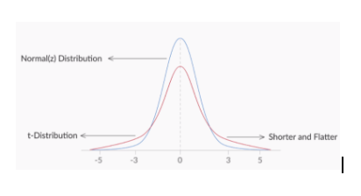
Sampling and Estimation
t-distribution
The properties of t-Distribution are as follows
It can only be applied when the samples are drawn from a normally distributed population.
It is flatter than a normal distribution.
Degrees of freedom = Sample size – Number of unknown parameters.
Standard normal variate or test statistic for t-distribution = (X̅i - μ)/(s/√n).
Refer to this link for more details.

Slide 17
Key Takeaway
Revision
Types of Sampling Methods
Standardised Normal Distribution and Z - Score
Sampling and Estimation
Key Takeaways
Data Science Certification Program
‹#›

Slide 18
#LifeKoKaroLift
Thank You!
‹#›

